Slide 1


Charge Injection System (CIS) Update
Katie Hughes, Dawit Belayneh, Peter Camporeale, Jacky Li
The University of Chicago
June 16, 2022

Slide 2

Welcome to our new CIS techs!! :)
Peter Camporeale
(pcamporeale@
uchicago.edu)
Jacky Li
(jackymengyangli@
uchicago.edu)

Slide 3
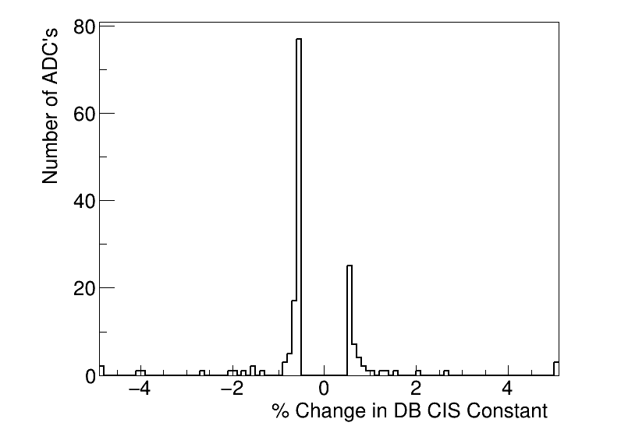
Summary
CIS runs from Jun. 23 - Jul. 12
Database will be updated tomorrow (Jul. 15)
161 channels in update
134 Good
5 >5% change
10 Masked
17 Affected

Slide 4
Run Selection
Many problems with Amplitude/Q in LBA (5 runs affected)
Timing changes for all partitions in the middle of June (10 runs affected)
Standard at the beginning of June
Shifted up 25 ns at June 11: changed by Jalal (log)
Shifted down 25 ns at June 14: also changed by Jalal (log)
Resolved June 23 by Henric (log)
We excluded all runs with bad amp/Q and timing. This leaves a large gap in the middle of June in our analysis.
To make the update more cohesive, we decided to additionally exclude the runs in the beginning of June, and instead take the runs from the end of June up until the most recent runs of July.
Runs used: 426084 426286 426330 426571 426701 426816 426968 427100 427157 427250 427419 427932 427941

Slide 5
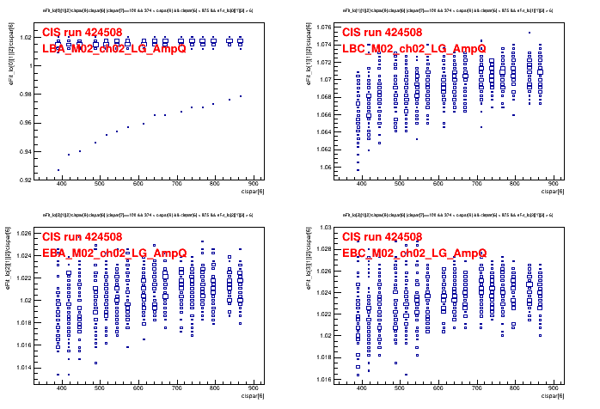
Amp/Q: 424508

Slide 6
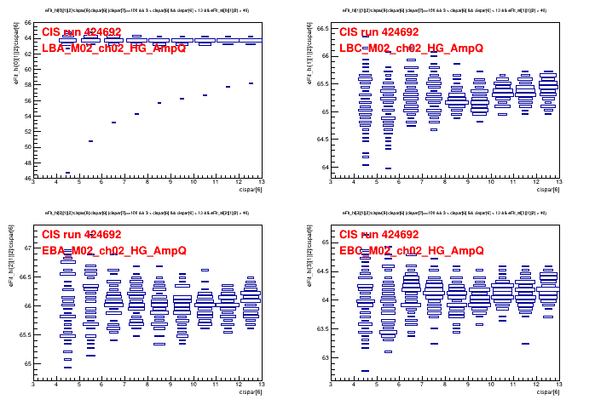
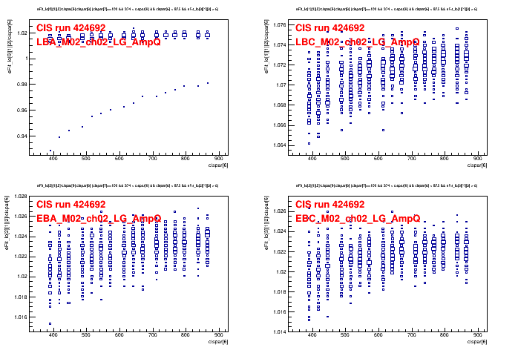
Amp/Q: 424692
Lowgain
Highgain

Slide 7
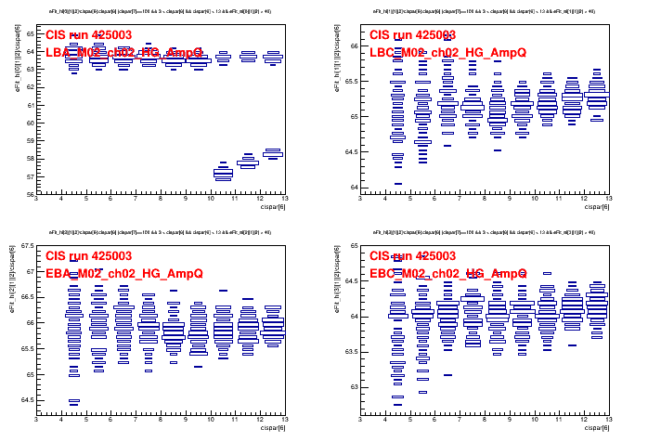
Amp/Q: 425003

Slide 8
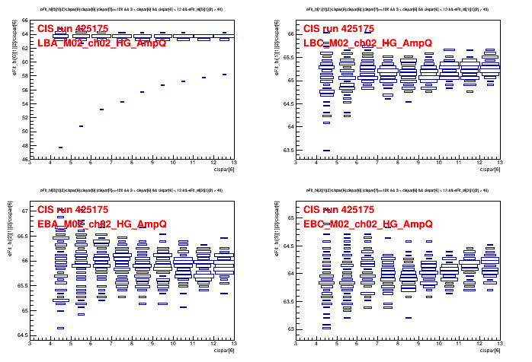
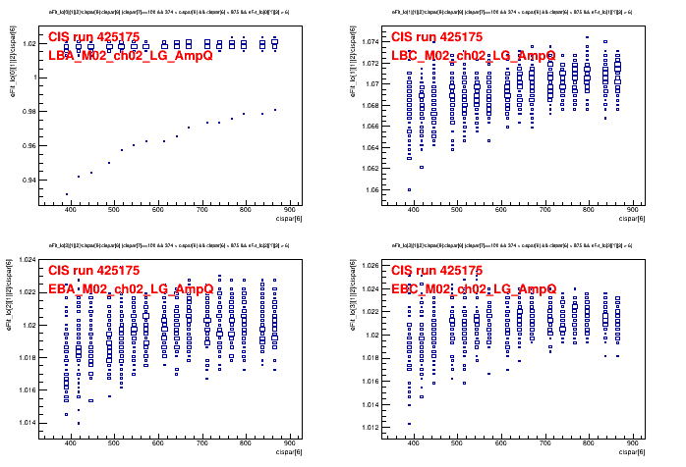
Amp/Q: 425175
Lowgain
Highgain

Slide 9
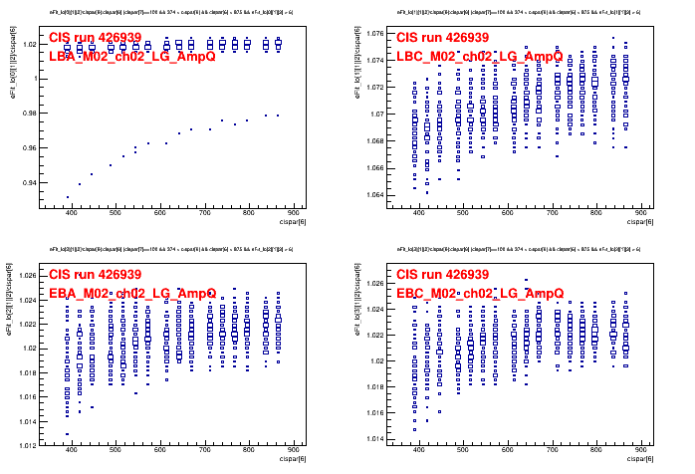
Amp/Q: 426939

Slide 10
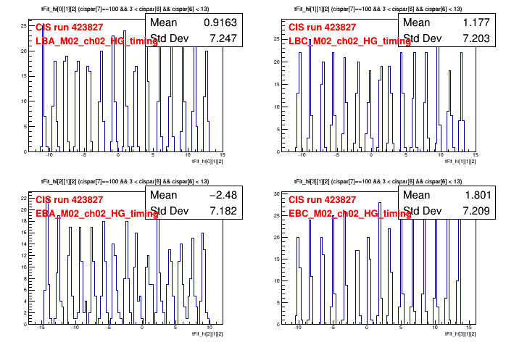
Timing: Beginning of June [-10, 15]

Slide 11
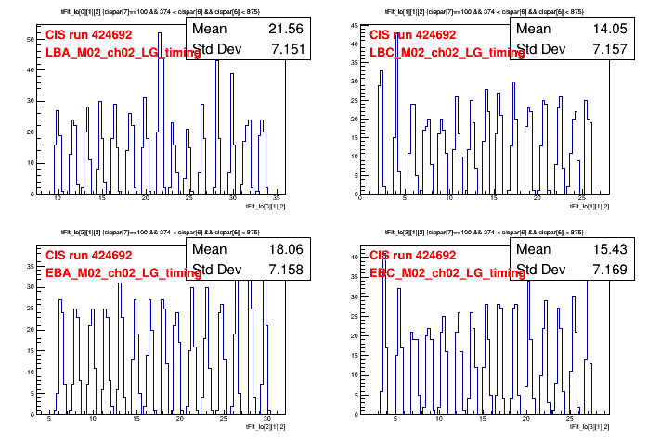
Timing: June 11-13 [10, 35]

Slide 12
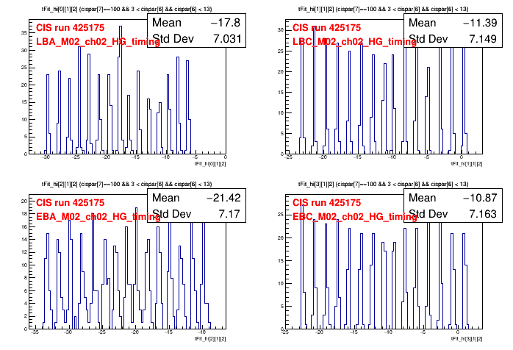
Timing: June 14 - June 23 [-30, -5]

Slide 13
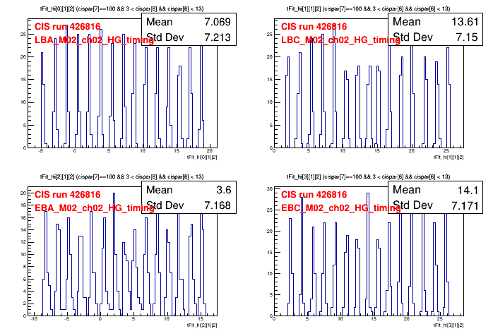
Timing: Remainder of June - present [-10, 15]

Slide 14
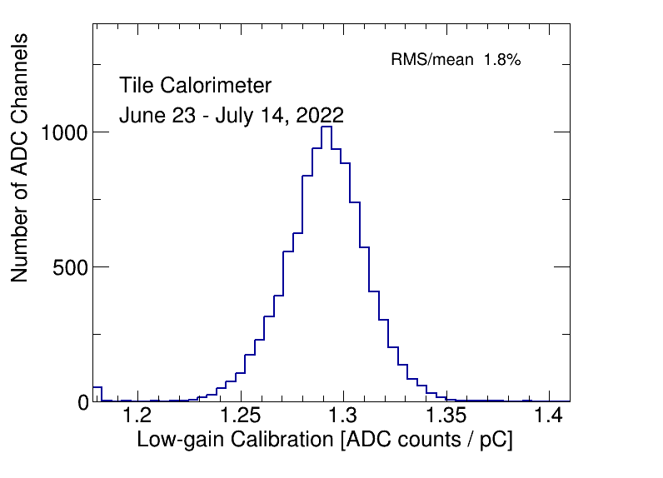
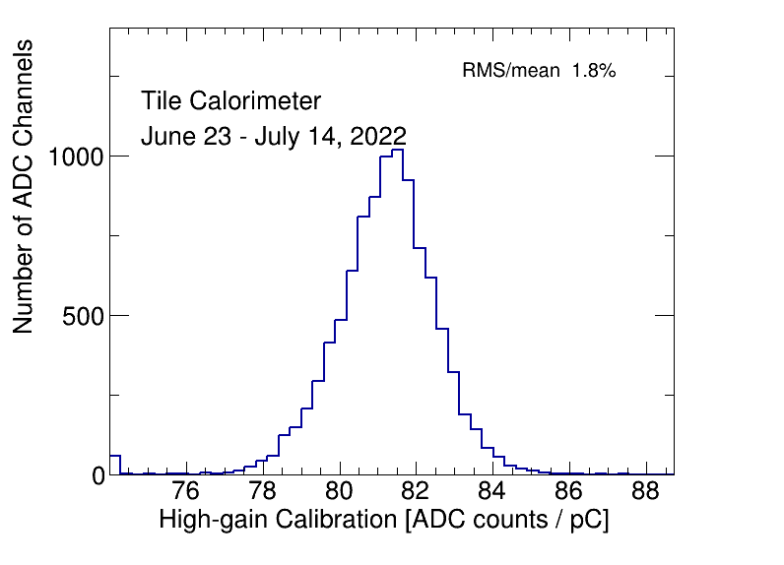
CIS constant distributions
Bump on HG distribution comes from demonstrator.
Bump on LG distribution?????

Slide 15
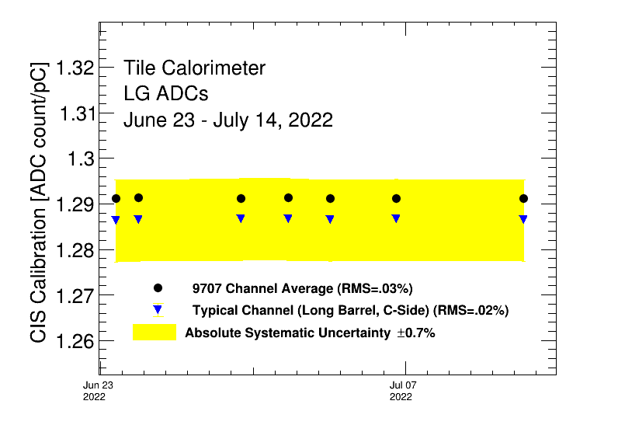
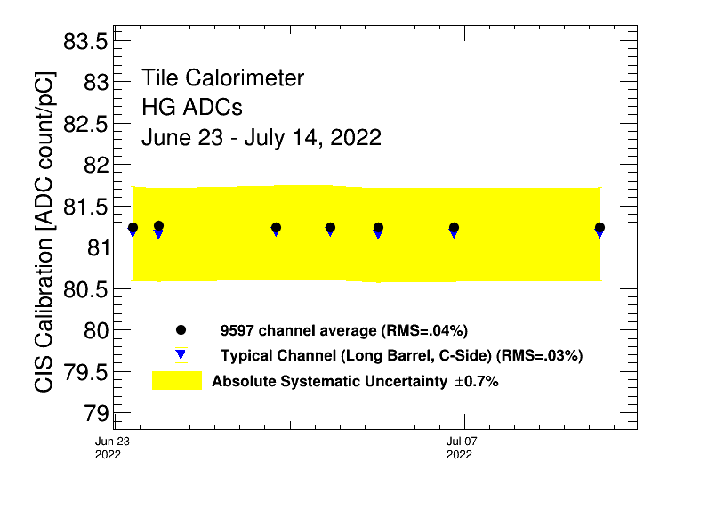
Detector Time Stability

Slide 16
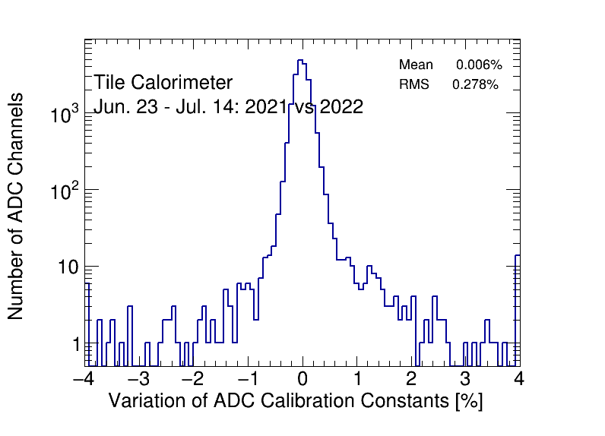
CIS constant stability: 2021 vs 2022

Slide 17
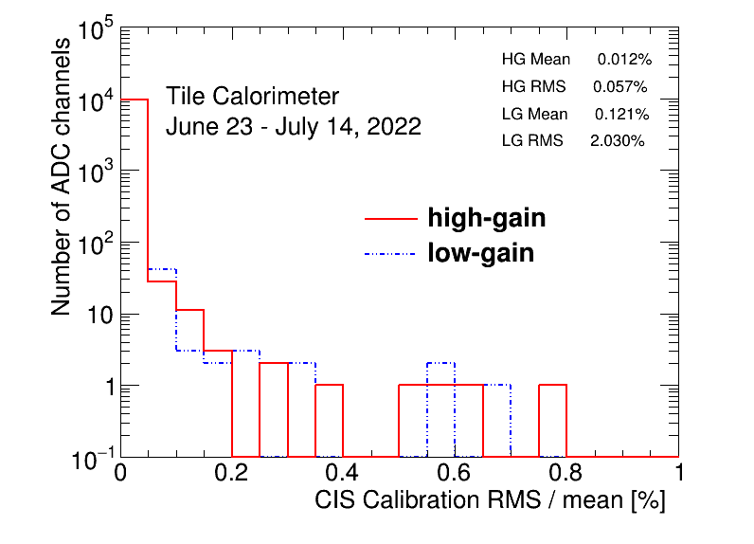
CIS constant RMS/mean

Slide 18
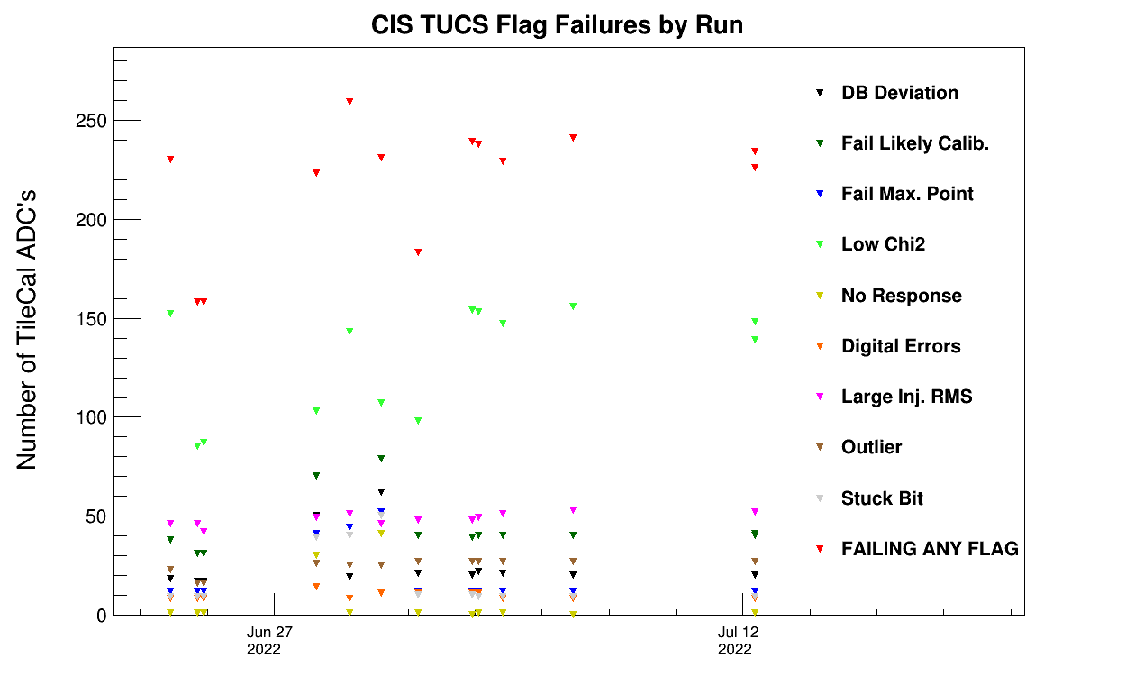
CIS TUCS Quality Flags
Notes:
**** which run is it that has the problems???

Slide 19
Interesting channel behaviour

Slide 20
High Deviation from DB Mean (5)
EBC_m22_c16_lowgain 1.24 1.02 -17.56%
EBC_m30_c11_highgain 74.23 78.71 6.04%
EBC_m30_c11_lowgain 1.19 1.26 5.98%
LBA_m62_c26_highgain 100.62 69.13 -31.30%
LBC_m52_c18_highgain 94.86 105.24 10.95%

Slide 21
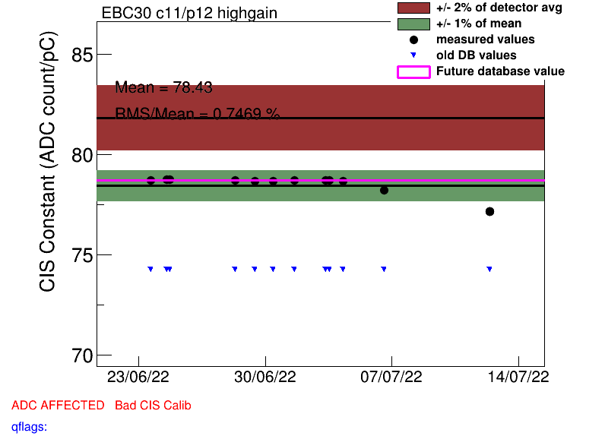
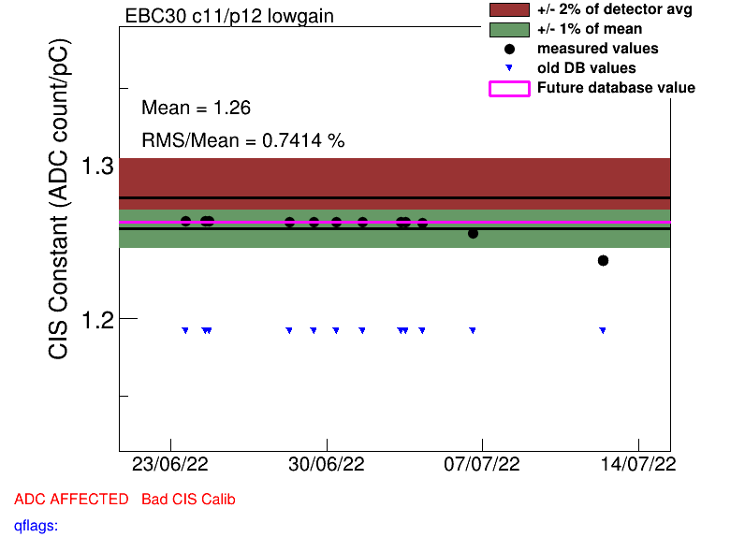
High Deviation in HG/LG (EBC30 c11)

Slide 22
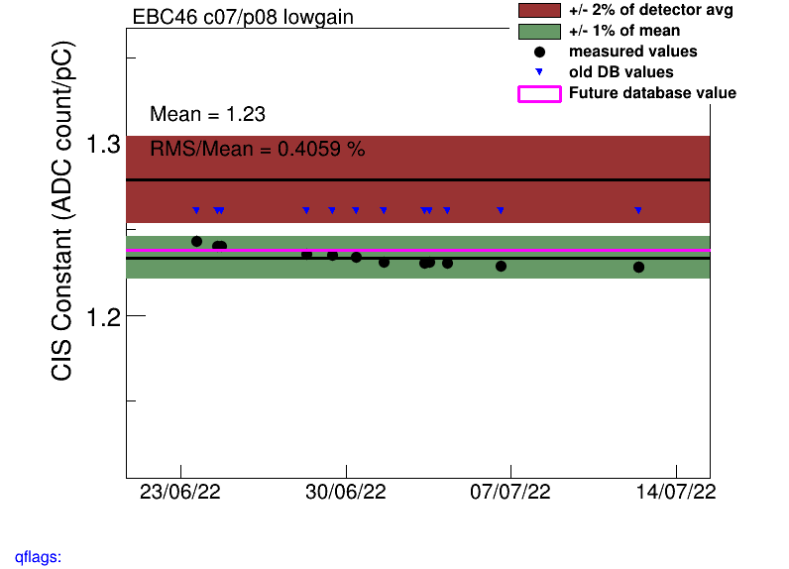
Drifting Channel: EBC46_c07_lowgain

Slide 23
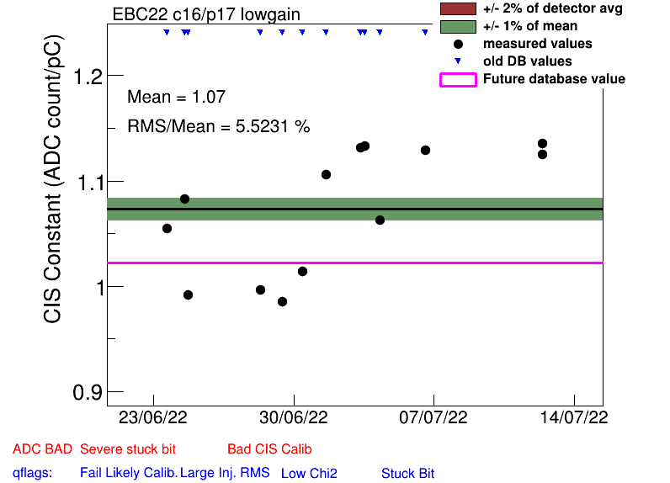
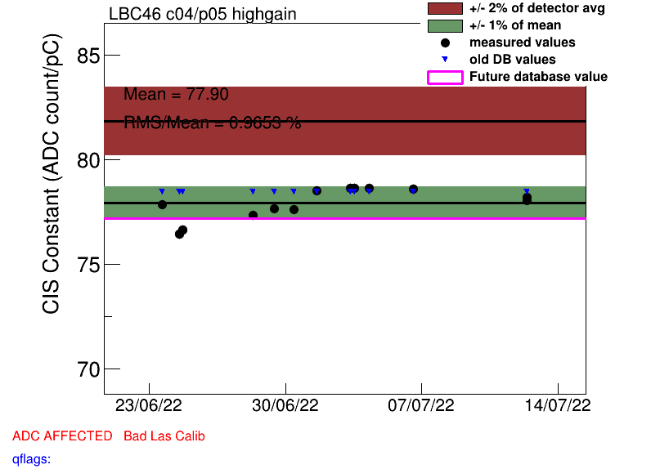
Some High Scatter Channels (unmasked)
EBC_m22_c16_lowgain
LBC_m46_c04_highgain

Slide 24
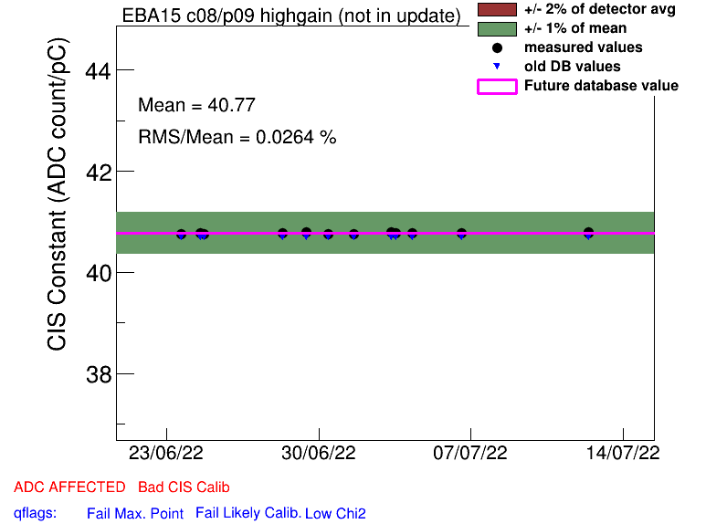
Half Gain Channels
EBA_m15_c08_highgain
EBA_m16_c00_highgain
EBA_m36_c15_highgain
EBA_m48_c31_lowgain
EBA_m64_c03_highgain
EBC_m09_c40_highgain
EBC_m21_c36_lowgain
LBA_m37_c19_highgain
LBC_m08_c03_lowgain
LBC_m19_c22_lowgain
(No changes from last update)
Affected
Masked
Notes:
No new half gain channels!

Slide 25
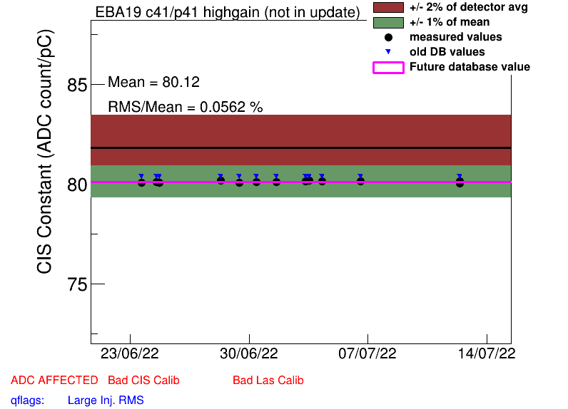
COOL Flag Updates
Remove BadCIS (2)
EBA_m19_c41_highgain
EBC_m20_c10_lowgain
Add BadCIS (5)
EBC_m46_c07_lowgain
EBC_m61_c08_lowgain
LBC_m28_c04_lowgain
LBC_m46_c04_highgain
LBC_m63_c45_highgain

Slide 26
